Slide 1
ECE191: Group D Audio, Visual, and Touch Communication
Mentor: Truong Nguyen, Siarhei Vishniakou
Linh Dinh, Francis Tsui, Joseph Lee

Slide 2
Agenda
Background
Project Overview
Statement of Work
Gantt Chart
Next Week’s Goals
Q&A

Slide 3
Background
“Sensing Fusion” – creating device that assimilates another sense into currently available devices on the market
Specifically: Touch
Design pressure sensor and array of actuators
Collect data from pressure sensor
Send data to produce pressure output on array of actuators
Application interface to make applicable

Slide 4
Project Overview
Design a mobile app (iOS or Android)
Receive data from Arduino over Bluetooth
Process data (at least 1 of the following):
Display a 3D surface plot of the data (drafting software)
Use data to drive a game
Drive an array of actuators (?)

Slide 5
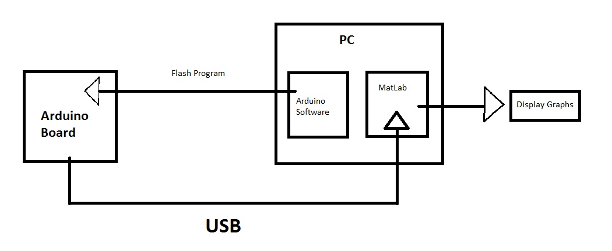
Statement of Work
Stage 1
Step 1: Flash program onto Arduino, emulating data of pressure sensor
Step 2: Receive data from Arduino in MATLAB via USB
Step 3: Do image processing on data

Slide 6
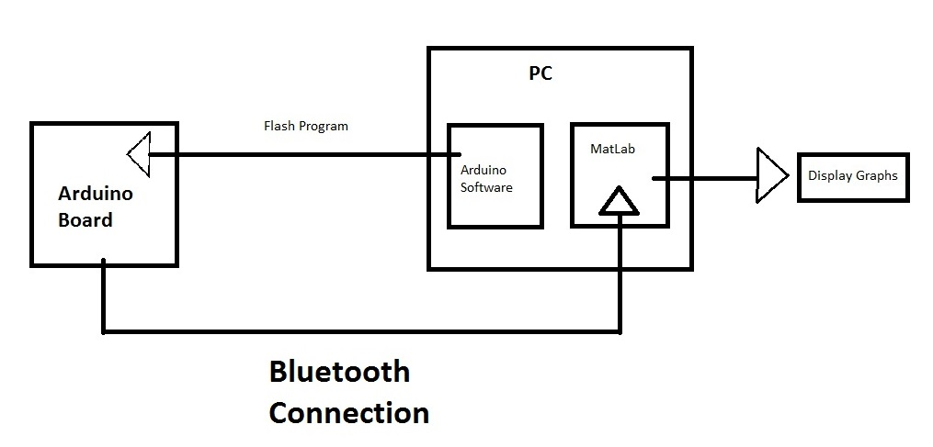
Statement of Work
Stage 2
Replace USB connection from stage 1 with Bluetooth connection
Notes:
Replacing Bluetooth connection into the system instead!

Slide 7
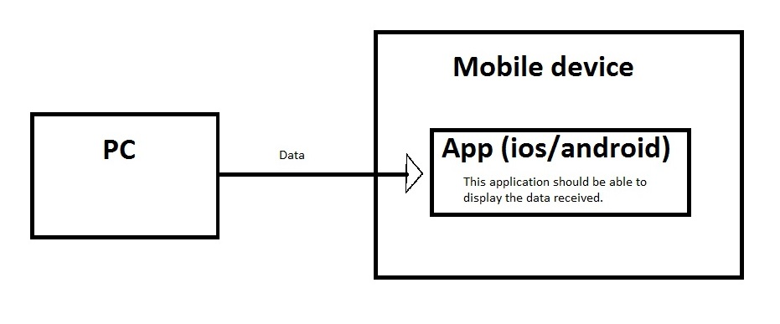
Statement of Work
Stage 3
App development to process data from sensor on mobile device
Device may include iOS, Android, Windows environment
Notes:
We want to make 2D or 3D graph on the phone to demonstrate abilities

Slide 8
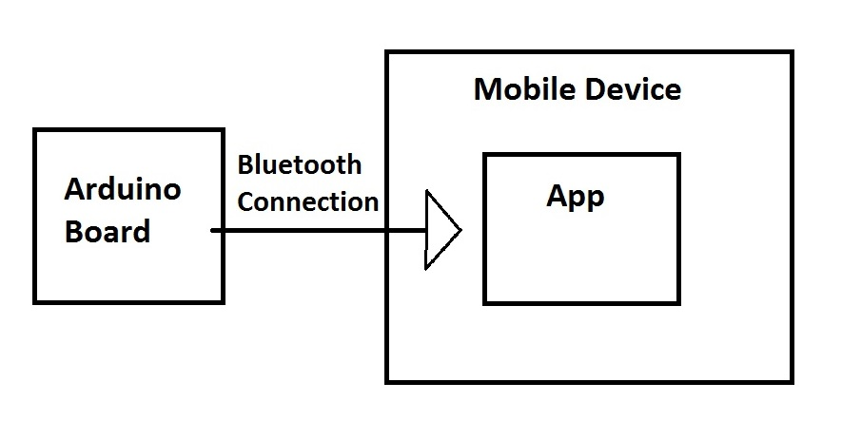
Statement of Work
Stage 4
Step 1: Receive data from Arduino via Bluetooth connection
Step 2: display data on application built from stage 3
Step 3: debug and finalize
Notes:
Configure the Bluetooth connection into the mobile app

Slide 9
Gantt Chart
Notes:
Mobile app, confirmed after meeting with professor. Focus of project: not just create, but understand API and interfacing. Last week: understanding project, catching up, premise more hardware based. This week: from gantt chart more research but want to be aggressive and start researching into writing app on platforms

Slide 10
Next Week’s Goals
Flash data from PC to Arduino
Demonstrate “hello world”
Flash code on Arduino that generates 8x8 random array
Research wired data transfer between Arduino and MATLAB
Notes:
1: want to show understanding of system level interfacing. 2: want to show understanding of syntax. 3: implemented through functions supported by Arduino. 4: synchronizing data between Arduino and another system

Slide 11
Thank you
Q&A session

